Slide 1
Manajemen Proyek SI
PROJECT MANAGEMENT PROCESSES

Slide 2
Pendahuluan
Project management is the application of knowledge, skills, tools, and techniques to project activities to meet the project requirements.
This application of knowledge requires the effective management of the project management processes.
Dikenal dengan istilah project development stage
“A system of practices, techniques, procedures, and rules used by those who work in a discipline” – PMBOK

Slide 3
Pendahuluan
Customers have higher expectations, seek increased time efficiencies, and demand ‘quantum’ performance improvements
IT efforts need documented path and procedures to better manage and control projects
The required Process Groups and their processes are guides for applying appropriate project management knowledge and skills during the project.

Slide 4
Project Life Cycle
A project life cycle is the series of phases that a project passes through from its initiation to its closure.
The phases are generally sequential, and their names and numbers are determined by the management and control needs of the organization or organizations involved in the project, the nature of the project itself, and its area of application.
The phases can be broken down by functional or partial objectives, intermediate results or deliverables, specific milestones within the overall scope of work, or financial availability.

Slide 5
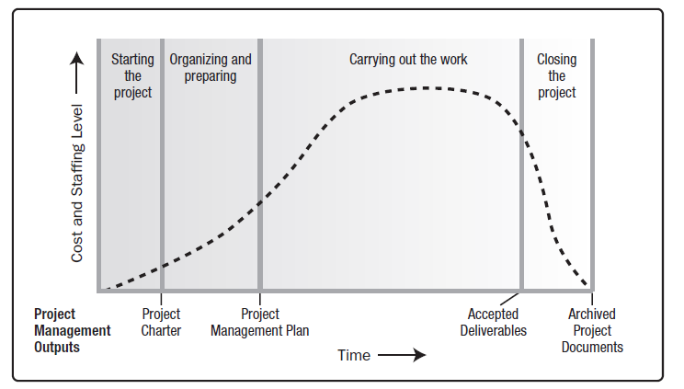
Generic Project Life Cycle Structure

Slide 6
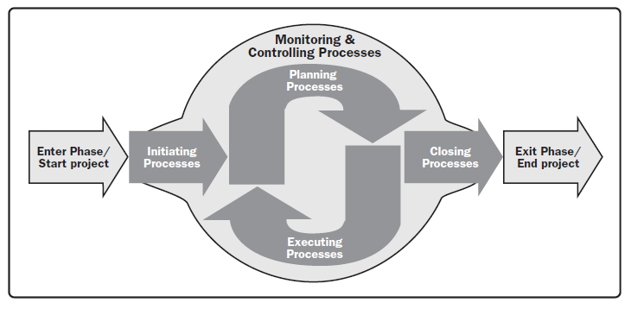
Project Management Process Groups

Slide 7
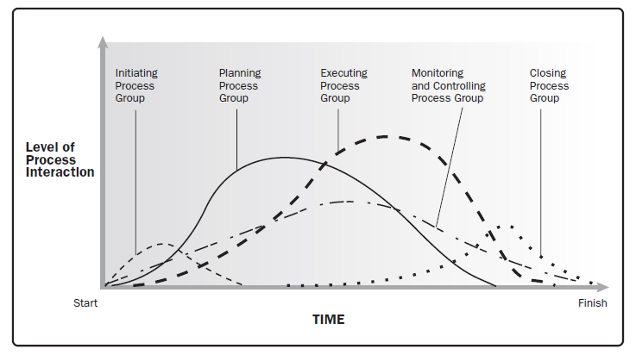
Process Groups Interact in a Phase or Project

Slide 8
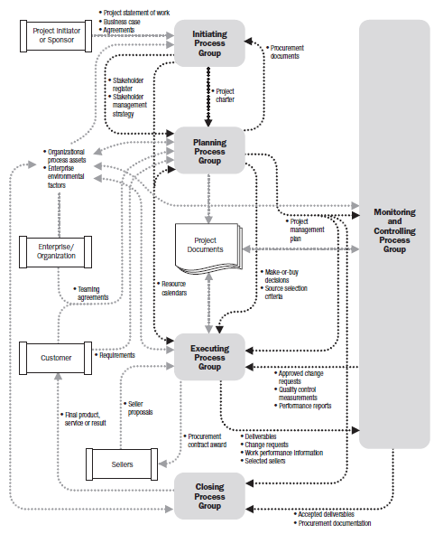
Project Management Process Interactions

Slide 10
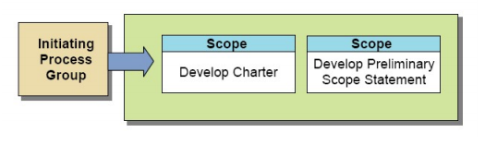
Project Initiation
obtaining authorization to start the project or phase
initial scope is defined and initial financial resources are committed. Internal and external stakeholders are identified

Slide 11
Project Initiation(2)
Pengertian
  Tahap awal suatu proyek
  Gambaran global dalam bentuk definisi proyek
    Ruang lingkup proyek
    Tujuan proyek
    Waktu pengerjaan proyek
    Biaya proyek, dll
Tujuan
  Mengidentifikasi CSF
  Menentukan tujuan proyek secara rinci
  Menentukan ruang lingkup
Hasil
  Project charter
  Stakeholder register

Slide 12
Project Planning
Pengertian
  Deskripsi detail dari definisi proyek yang dibuat
  Berbentuk project management plan dan project documents
    Scope management
    Time management
    Cost management
    Resource management
    Risk management
    Communication management
    Procurement management
    Integration management

Slide 13
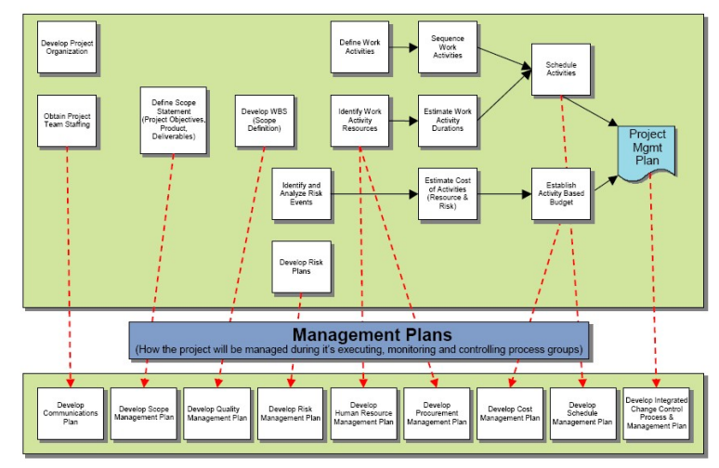
Project Planning

Slide 14
Project Execution
Coordinating people and resources,
Managing stakeholder expectations,
Integrating and performing the activities of the project in accordance with the project management plan.
May require planning updates and rebaselining
  Changes to expected activity durations,
  changes in resource productivity and availability,
  unanticipated risks.

Slide 15
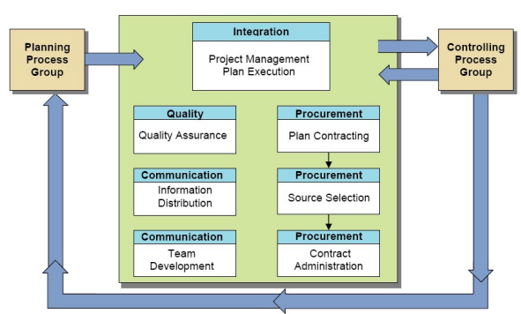
Project Execution

Slide 16
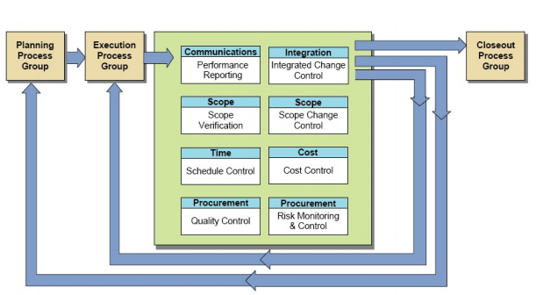
Project Controlling

Slide 17
Project Controlling
Pengertian
  Pengontrolan terhadap kegiatan atau aktifitas suatu proyek.
Tujuan
  Memastikan pencapaian tujuan proyek apakah sesuai dengan target yang telah ditentukan.
  Memastikan apakah project management plan perlu diperbaharui atau tidak.
Mekanisme
  Kontrol terhadap waktu, ruang lingkup, kualitas
  Kontrol terhadap biaya atau cost
  Pelaporan status kemajuan proyek
  Re-planning jika diperlukan

Slide 18
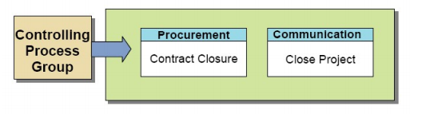
Project Closure

Slide 19
Project Closure
Pengertian
  Memberikan laporan tentang seluruh hasil yang diperoleh selama pengerjaan proyek dalam bentuk dokumen laporan.
Tujuan
  Secara formal mengakhiri proyek dengan semua stakeholder
Mekanisme
  Laporan pelaksanaan pekerjaan
  Laporan penyelesaian pekerjaan
  Berita acara penyelesaian pekerjaan
  Berita acara serah terima pekerjaan
  Pembubaran tim proyek

Slide 20
Why Do Project Fail?

Slide 21
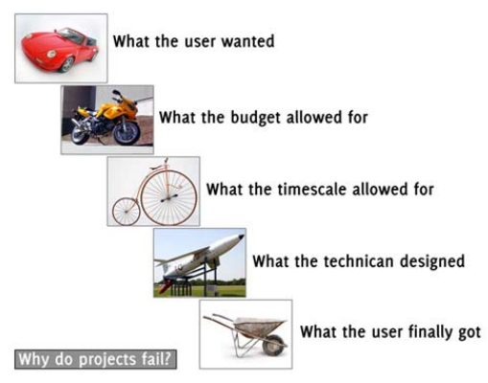
Project Failure

Slide 22
Project Failure
New user acceptance
Insufficient contingency planning
Lack of thorough testing
Knowledge transfer
Ineffective communication
Assumptions
People problems
Decision making/authority

Slide 23
Project Failure
Poor project specification
Timescales that are too long
Inappropriate staff
Insufficient involvement by senior management
Failure to manage user expectations
Failure to manage the change required

Slide 24
Project Failure
NASA’s Mars Climate Orbiter Project
  two teams involved in the space probe development were using different systems of measurement – one was using metres, centimetres and kilogrammes, the other was using feet, inches and pounds.

Slide 25
Successful Project
Select appropriate processes required to meet the project objectives
Use a defined approach that can be adapted to meet requirements
Establish and maintain appropriate communication and engagement with stakeholders
Comply with requirements to meet stakeholder needs and expectations
Balance the competing constraints of scope, schedule, budget, quality, resources, and risk to produce the specified product, service, or result

Slide 26
Project Management Process dan PMBOK
Integration
Management
Project Management Phases
Procurement
Management
Scope
Management
Risk
Management
Initiation
Planning
Time
Management
Control
Execution
Communications
Management
Cost
Management
Closeout
Human Resource
Management
Quality
Management
Knowledge Areas

Slide 27
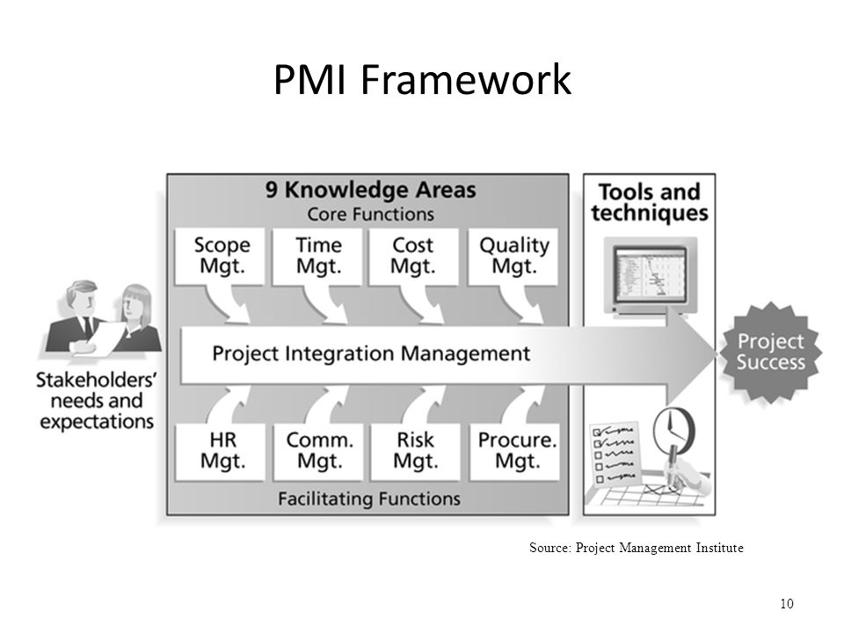
Framework Manajemen Proyek

Slide 28
Knowledge area
Manajemen Proyek

Slide 29
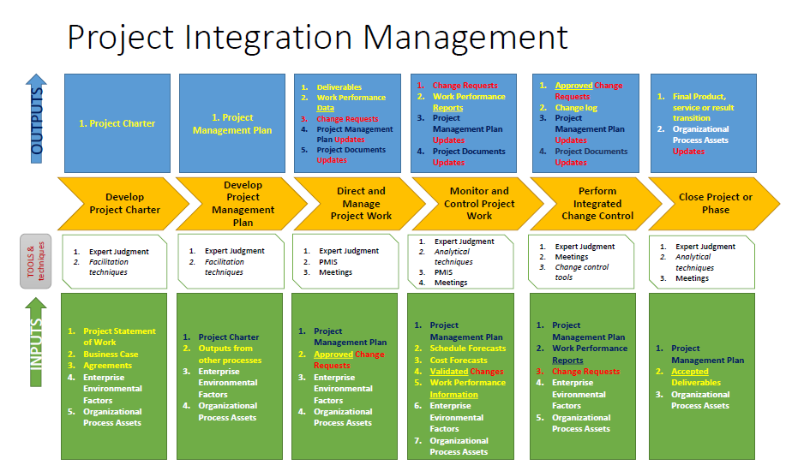

Slide 30
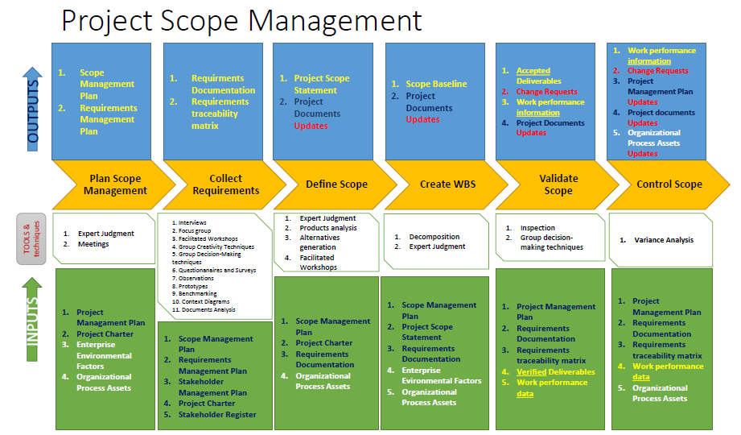

Slide 31
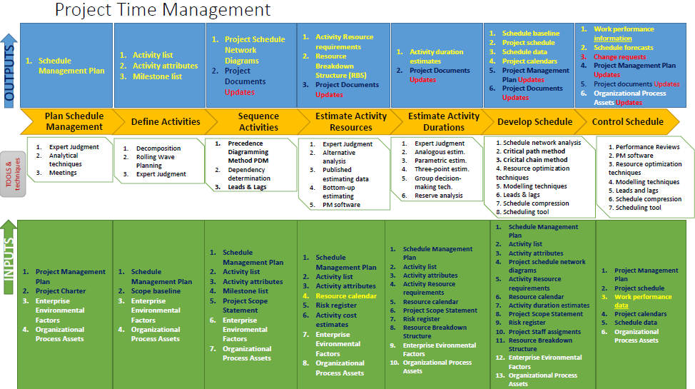

Slide 32
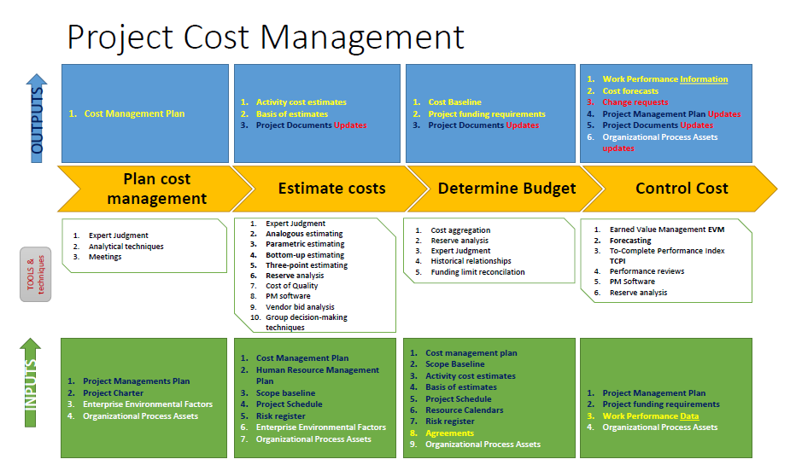

Slide 33
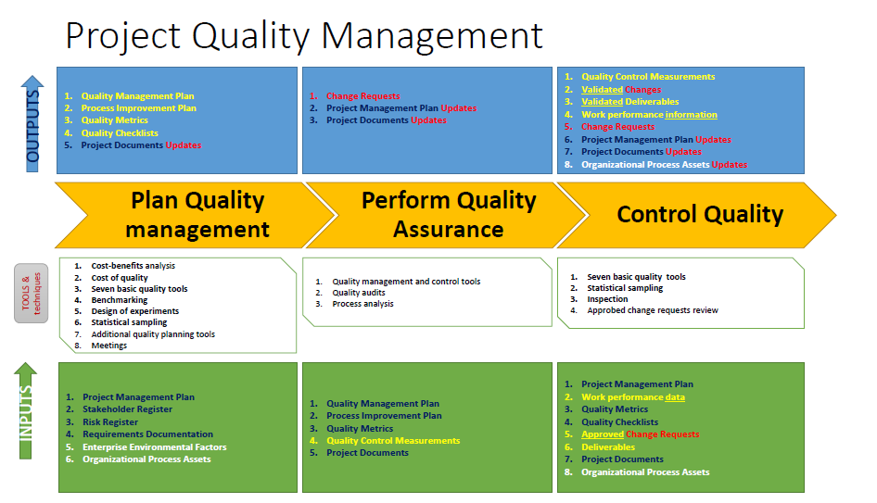

Slide 34
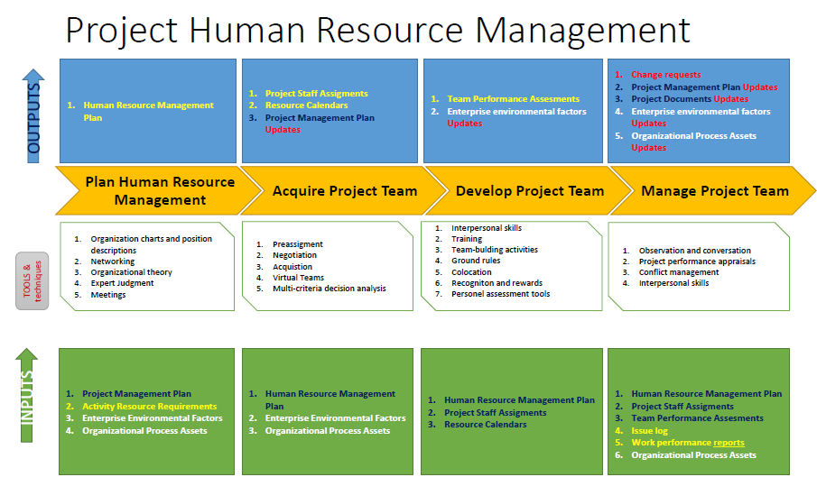

Slide 35
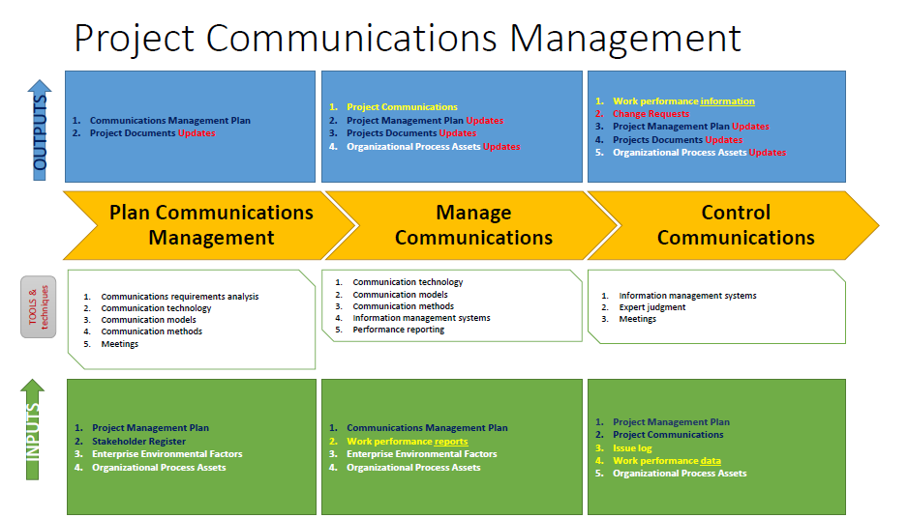

Slide 36
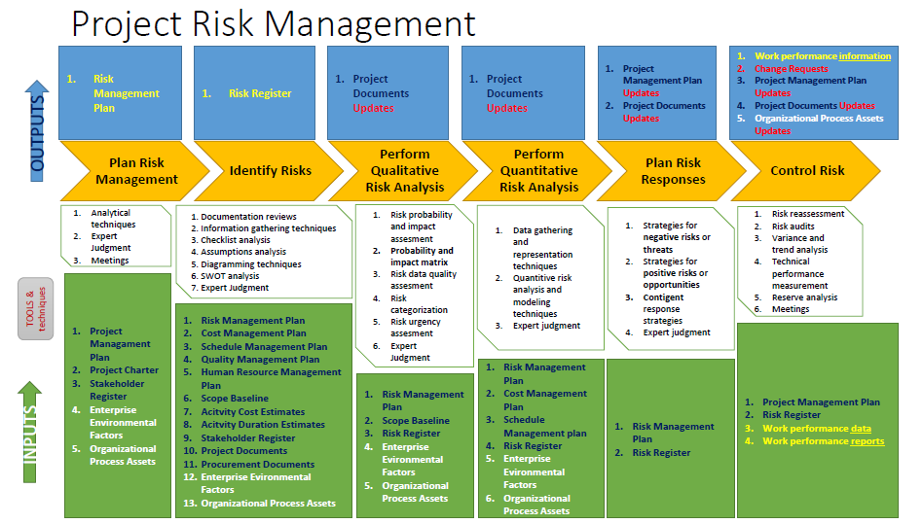

Slide 37
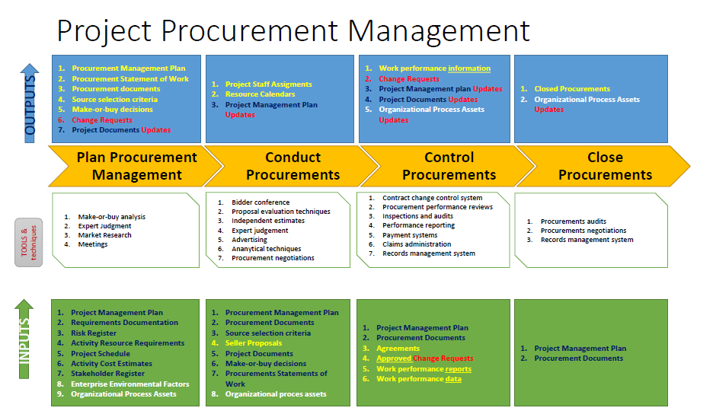

Slide 38
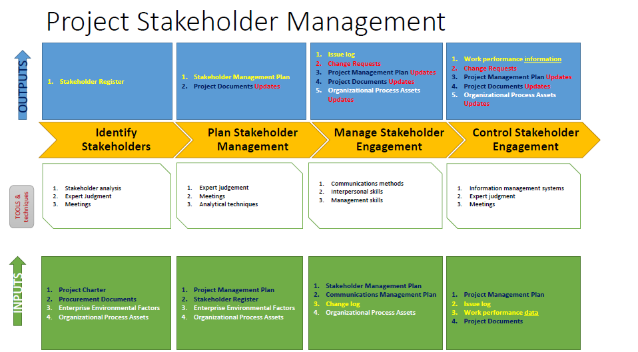

Slide 39
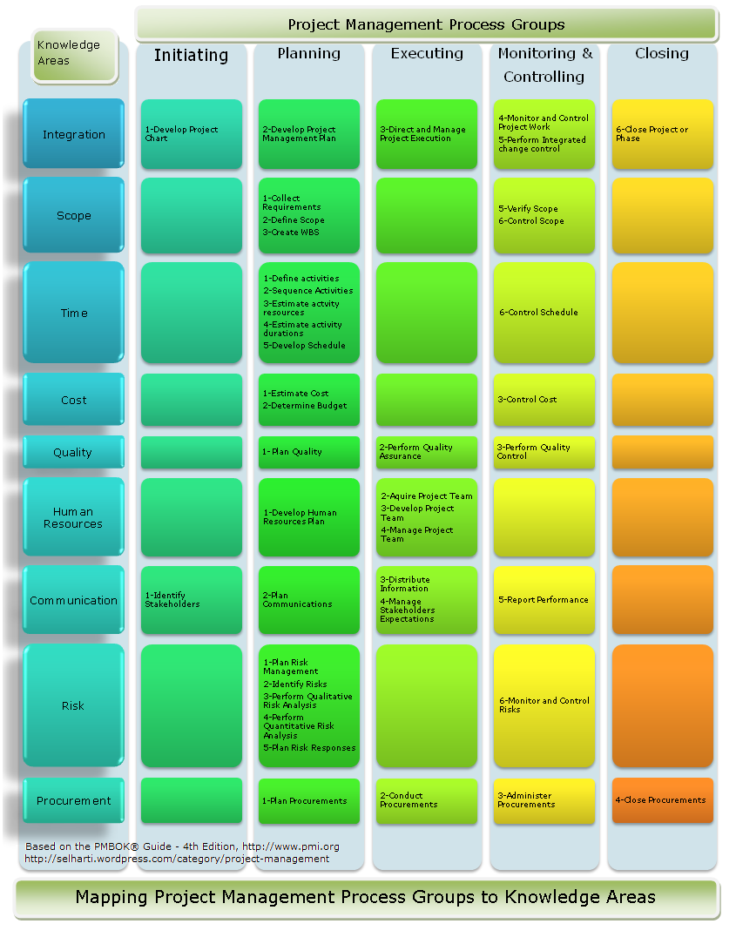

Slide 40
Thank You for Listening!

